Slide 1

Programming with Cosmos DB

Slide 2
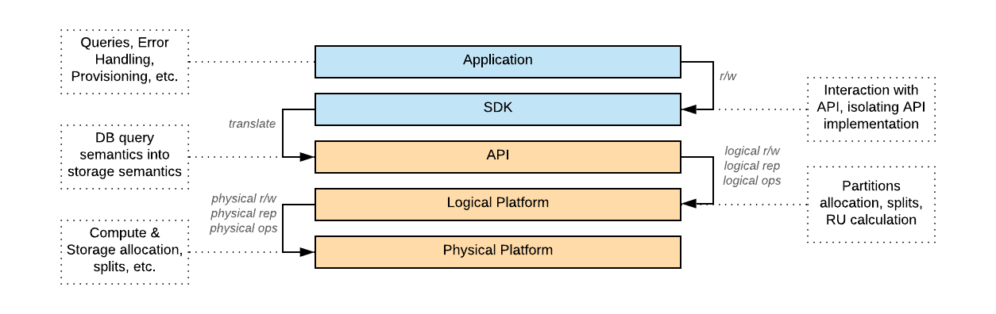
How is Cosmos DB organized?

Slide 3
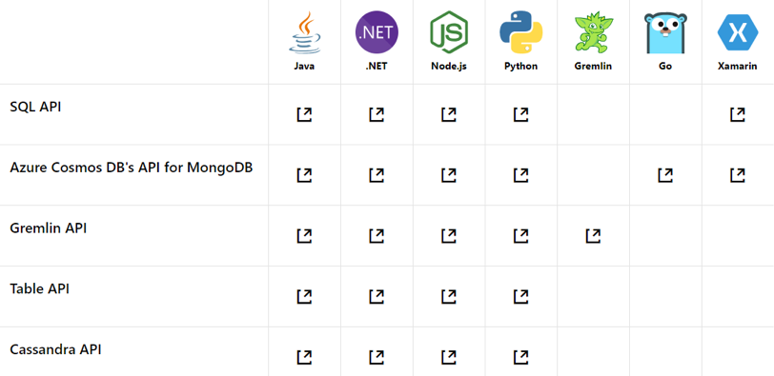
Which SDKs does Cosmos DB support?
V2, v3, v4

Slide 4
Main differences in .NET SDK for SQL API
RUs are consumed on a per-operation basis
RUs consumed for the fully identical operations should be exactly same
RU consumption per operation, including:
Write (write indexing) – depends on the Document size, Consistency Level and Deployment
Read – depends on the Document size, Consistency Level and Deployment
Change Feed
Aggregations
Partition Split (RUs are not directly used but split may affect over operations)

Slide 5
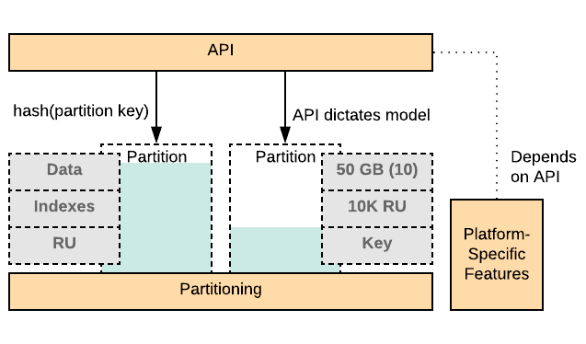
What is Cosmos DB (under the hood)?
Partition is an ultimate unit which defines:
How many items (data, including indexes) with the same key can be stored.
How many read and write operations can be performed against dataset defined by the key.

Slide 6
Cosmos DB Deployments and Consistency in Global Distribution scenario
Consistency Level | Guarantees | Read cost | Comment
Strong | Linearizability (once operation is complete, it will be visible to all) | 2 | Quorum read (normalized to cost factor of 2 even when reading from three replicas) Only allowed in regions close to each other – no latency or availability SLA guarantees for writes – we can’t control physics ☺
Bounded Staleness | Consistent Prefix. Reads lag behind writes by at most k prefixes or t interval Similar properties to strong consistency (except within staleness window) | 2 | Quorum read (normalized to cost factor of 2 even when reading from three replicas) In single write region identical with Strong – but replication happens asynchronously to other regions
Session | Consistent Prefix. Within a session: monotonic reads, monotonic writes, read-your-writes, write-follows-reads Predictable consistency for a session, high read throughput + low latency | 1 | This is the default consistency model Ideally mutable session token can flow end-to-end – otherwise only single CosmosDB client benefits from predictable consistency within session
Consistent Prefix | Reads will never see out of order writes (no gaps). | 1 | My recommendation (over Session) when it is impossible to flow mutable session token end-to-end because it makes expectations clearer
Eventual | Potential for out of order reads. Lowest cost for reads of all consistency levels. | 1

Slide 7
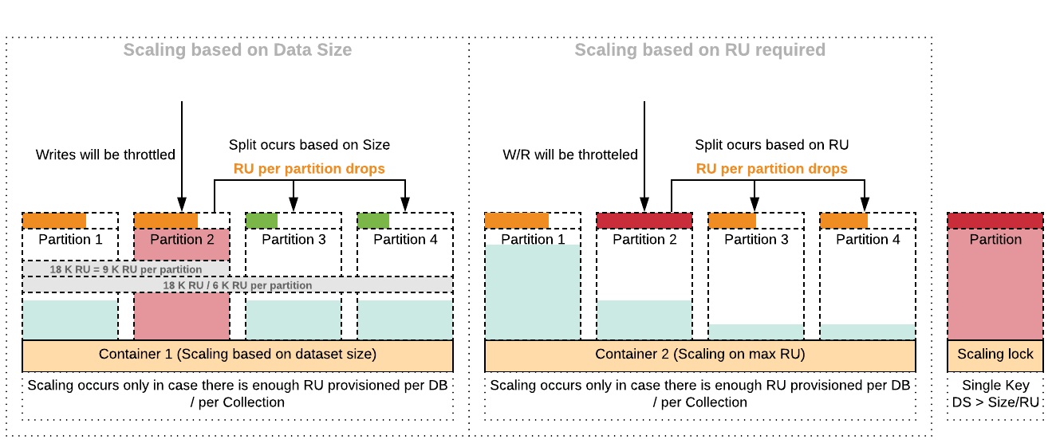
How does Cosmos DB scale?

Slide 8
Fixed RU per operation
RUs are consumed on a per-operation basis
RUs consumed for the fully identical operations should be exactly same
RU consumption per operation, including:
Write (write indexing) – depends on the Document size, Consistency Level and Deployment
Read – depends on the Document size, Consistency Level and Deployment
Change Feed
Aggregations
Partition Split (RUs are not directly used but split may affect over operations)

Slide 9

Before we begin: Couple of typical pitfalls

Slide 10
SQL API is ANSI SQL
no, No, NO, NOT AT ALL
Similar syntax with different execution model
Very limited capabilities of Query Planner
Less capabilities in terms of traditional DB optimizations (caching, indexing, hints, etc.)
Lookup approach is generally better than large scans / aggregations
Different cost implications
Every action is directly associated with the cost (aggregation, cross-partition queries, updates, large-document writes, heavy indexes)
Different approach for data modelling
Application needs to be adopted to the way DB works

Slide 11
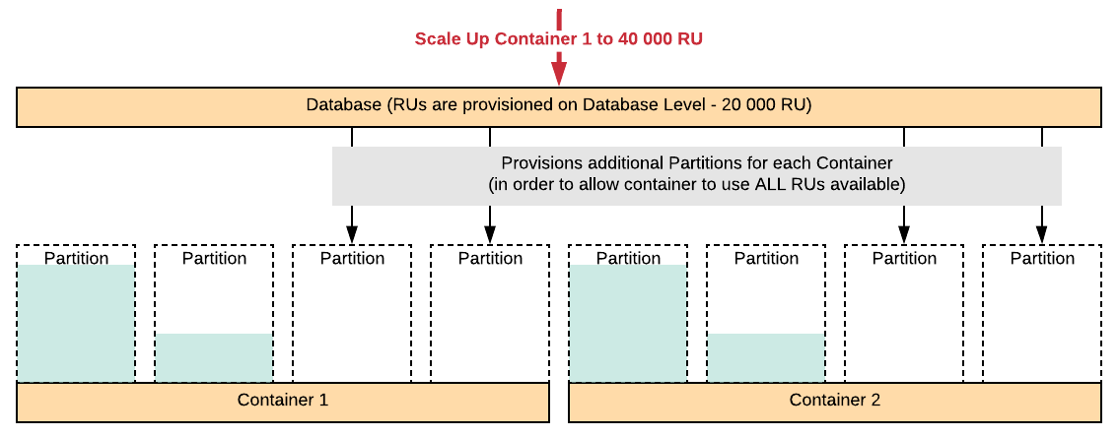
NO Independence from Provisioning Model
Database Provisioning model – only for test / lots of small containers
Container Provisioning model – for large-scale production containers

Slide 12
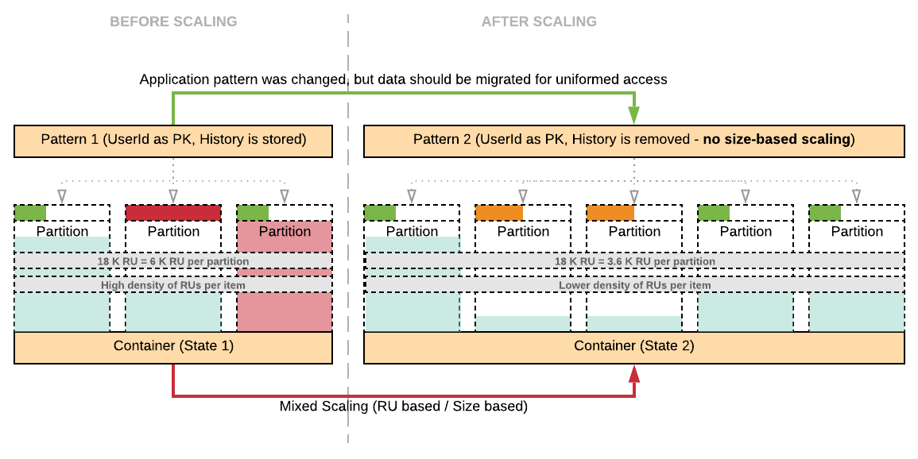
NO Self-balancing Performance

Slide 13
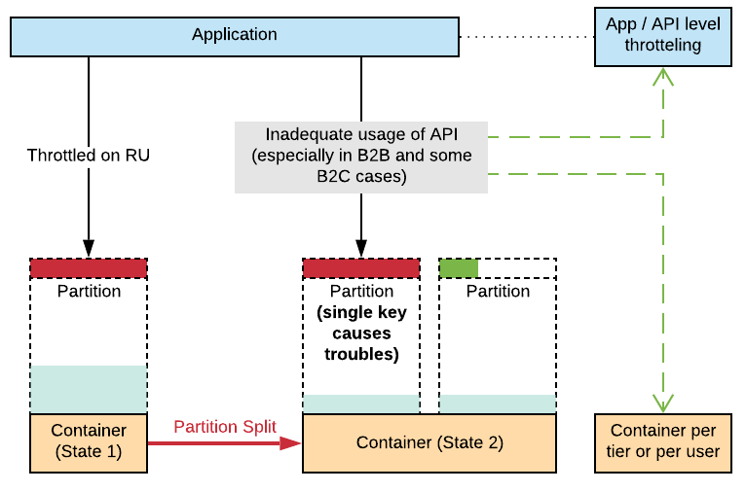
Limitless Scalability – Not with the single key
10 000 RU on Read AND Write on a single key
Writes
Larger than 1 KB
Heavy Indexed Writes
Highly Consistent Writes
Multi-Region Writes
Consume additional RUs
Indexes
Consume additional RUs on writes
Change Feed
Consumes RUs
Aggregations (up to thousands RUs per query – in case of cross partition query)
SORT BY, ORDER BY, GROUP BY on unindexed field, on a large dataset

Slide 14
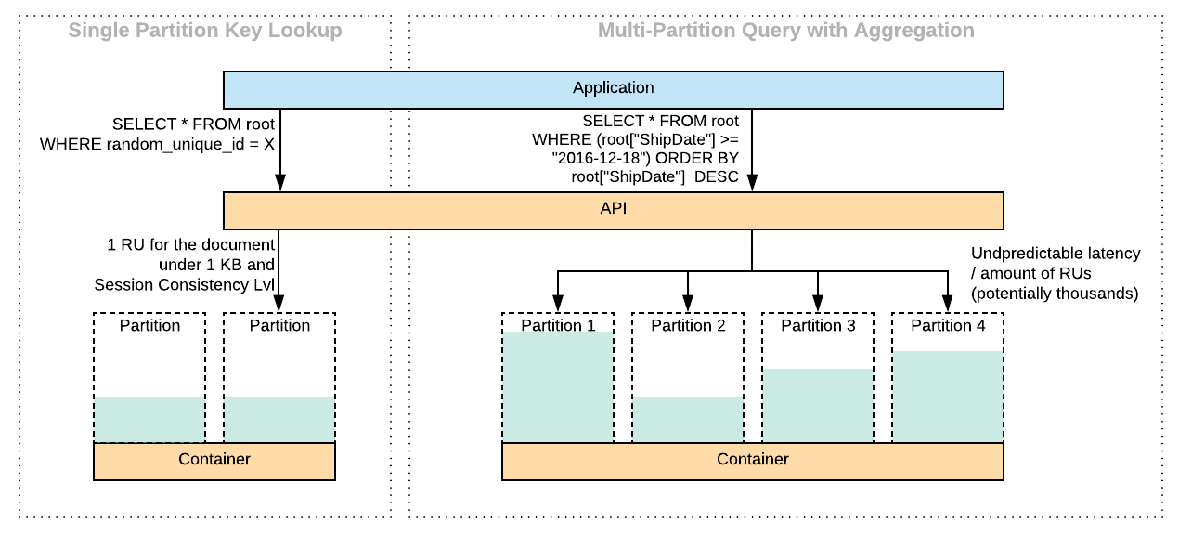
NO Independence from Model (Schema less)

Slide 15
NO Independence from API / SDK
Different APIs have different capabilities and compatibility
SQL API has most of the newest features.
Cassandra API is compatible with Cassandra Driver (v 4.0)
MongoDB is partially compatible with version (3.4 & 3.6 will come soon)
Gremlin API doesn’t support many graph native approaches.
Not all of the APIs can be used together
Only Gremlin API and SQL API are interoperable.
Different SDKs within the same API have different capabilities
Typically .NET SDKs are the most comprehensive and powerful ones.
Maturity of other SDKs differs between language.

Slide 16

Programming with Cosmos DB

Slide 17
Basic Data Ingestion
CosmosContainer container = cosmosClient.GetContainer(Program.DatabaseId, Program.ContainerId);
try
{
// Read the item to see if it exists.
ItemResponse<Family> andersenFamilyResponse = await container.ReadItemAsync<Family>(andersenFamily.Id, new PartitionKey(andersenFamily.LastName));
Console.WriteLine("Item in database with id: {0} already exists\n", andersenFamilyResponse.Value.Id);
}
catch(CosmosException ex) when (ex.Status == (int)HttpStatusCode.NotFound)
{
// Create an item in the container representing the Andersen family. Note we provide the value of the partition key for this item, which is "Andersen"
ItemResponse<Family> andersenFamilyResponse = await container.CreateItemAsync<Family> (andersenFamily, new PartitionKey(andersenFamily.LastName));
// Note that after creating the item, we can access the body of the item with the Resource property off the ItemResponse.
Console.WriteLine("Created item in database with id: {0}\n", andersenFamilyResponse. Value.Id);
}

Slide 18
Data ingestion: Optimal Write
Items are within 1 KB range (with payload ~600 bytes)
Document has a flat structure
Document has unique Partition Key
Document has as few indexed fields as possible

Slide 19
Data Ingestion with Monitoring and Provisioned Capacity Management
Header | Description
Content-Type | The Content-Type is application/json. The SQL API always returns the response body in standard JSON format.
Date | The date time of the response operation. This date time format conforms to the RFC 1123 date time format expressed in Coordinated Universal Time.
etag | The etag header shows the resource etag for the resource retrieved. The etag has the same value as the _etag property in the response body.
x-ms-activity-id | Represents a unique identifier for the operation. This echoes the value of the x-ms-activity-id request header, and commonly used for troubleshooting purposes.
x-ms-alt-content-path | The alternate path to the resource. Resources can be addressed in REST via system generated IDs or user supplied IDs. x-ms-alt-content-path represents the path constructed using user supplied IDs.
x-ms-continuation | This header represents the intermediate state of query (or read-feed) execution, and is returned when there are additional results aside from what was returned in the response. Clients can resubmitted the request with a request header containing the value of x-ms-continuation.
x-ms-item-count | The number of items returned for a query or read-feed request.
x-ms-request-charge | This is the number of normalized requests a.k.a. request units (RU) for the operation. For more information, see Request units in Azure Cosmos DB.
x-ms-resource-quota | Shows the allotted quota for a resource in an account.
x-ms-resource-usage | Shows the current usage count of a resource in an account. When deleting a resource, this shows the number of resources after the deletion.
x-ms-retry-after-ms | The number of milliseconds to wait to retry the operation after an initial operation received HTTP status code 429 and was throttled.
x-ms-schemaversion | Shows the resource schema version number.
x-ms-serviceversion | Shows the service version number.
x-ms-session-token | The session token of the request. For session consistency, clients must echo this request via the x-ms-session-token request header for subsequent operations made to the corresponding collection.

Slide 20
Main caveats of Data Ingestion
Single Writes
5 RUs per 1 KB write
Ideally to keep the document under 700 bytes
Bulk Writes
Makes sense to disable indexes before ingestion and rebuild them after
Control ingestion flow and optimize around number / size of docs
Keep an eye on 429s
Randomize ingestion on partitions
Provision in advance, then reduce RUs to the necessary level
Do not overprovision more than 25% of the target RU capacity

Slide 21
Indexing
Range index kind is used for:
Equality queries
Equality match on an array element
Range queries
Checking for the presence of a property
String prefix matches
ORDER BY queries
JOIN queries
Spatial index kind is used for:
Geospatial distance queries
Geospatial within queries
Geospatial intersect queries
Composite index kind is used for:
ORDER BY queries on multiple properties
Queries with a filter and ORDER BY (only if in ORDER BY clause).
Queries with a filter on two or more properties where at least one property is an equality filter
SELECT * FROM c WHERE ST_INTERSECTS(c.property, { 'type':'Polygon', 'coordinates': [[ [31.8, -5], [32, -5], [31.8, -5] ]] })
SELECT * FROM container c WHERE c.property > 'value'

Slide 22
Indexing policies
Opt-out
Opt-in
{
"indexingMode": "consistent",
"includedPaths": [
{
"path": "/*"
}
],
"excludedPaths": [
{
"path": "/path/to/single/excluded/property/?"
},
{
"path": "/path/to/root/of/multiple/excluded/properties/*"
}
]
}
{
"indexingMode": "consistent",
"includedPaths": [
{
"path": "/path/to/included/property/?"
},
{
"path": "/path/to/root/of/multiple/included/properties/*"
}
],
"excludedPaths": [
{
"path": "/*"
}
]
}

Slide 23
Basic Data Querying
Read Query Semantics
SELECT subdocument
SELECT <select_list>
[FROM <optional_from_specification>]
[WHERE <optional_filter_condition>]
[ORDER BY <optional_sort_specification>]
[JOIN <optional_join_specification>]
SELECT
p.id,
p.manufacturer
FROM Products p
WHERE p.id ="1"
WHERE
ORDER BY
SELECT *
FROM Products p
WHERE p.id ="1"
SELECT p.price, p.description, p.productId
FROM Products p
ORDER BY p.price ASC
JOIN
SELECT p.productId
FROM Products p
JOIN p.shipping

Slide 24

Data querying: Read vs. Lookup
For heavy read/query scenarios it can be beneficial to denormalize data to allow retrieval by point-lookups vs. queries to avoid the RU charges for compute overhead with queries
RU charge for point-lookup of 1 KB document (with Session or lower consistency) is 1 RU.
Query ‘SELECT * FROM c WHERE c.id == “<RowKey>” and c.pk == “<PartitionKey>”’ for the same document would cost nearly 3 RU
Often only useful when certain queries are executed very often. Example: Xbox Licensing service with around 100 K requests per second saved roughly 25% of RUs with this optimization

Slide 25
Data querying: Optimal Query
Returned items are within 1 KB range (with payload ~600 bytes)
Returned document has a flat structure
The predicate is as narrow as it is possible
GROUP BY clause is omitted
ORDER BY indexed field
Example: Using Composite Index on c.name, c.age, c.timestamp
SELECT * FROM c WHERE c.name = "John", c.age = 18 ORDER BY c.name, c.age, c.timestamp

Slide 26
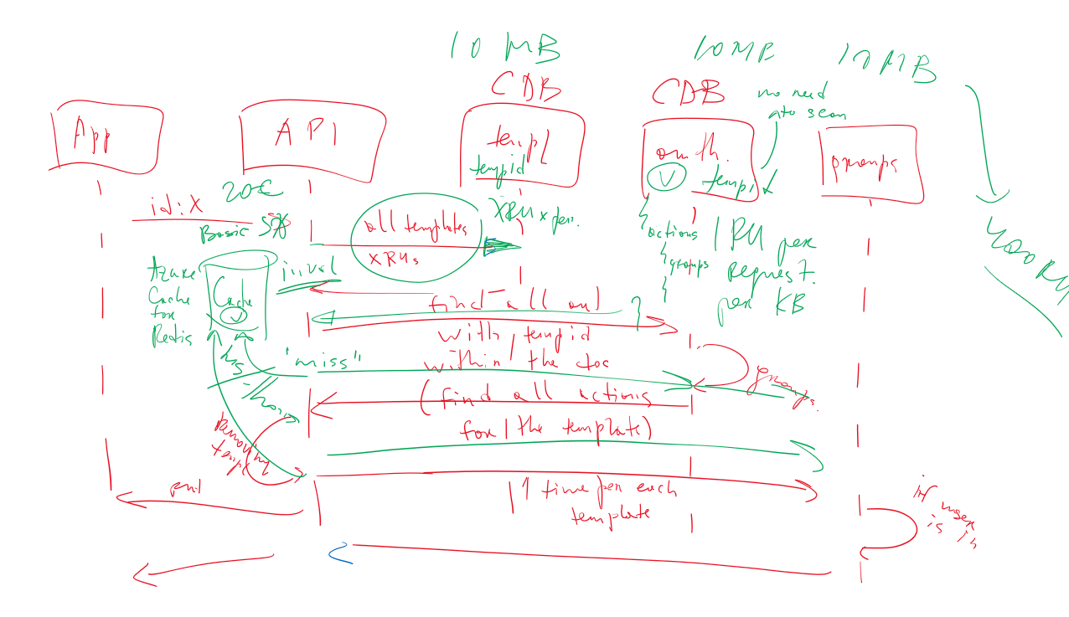
Example: 32 requests per single Authorization

Slide 27
Example: Storing and Querying via References
{
"partitionKey": "RIXA83JDGJ63UO86D-2020-02",
"entityType": "VehicleTelemetry",
"ttl": 5184000,
"tripId": null,
"vin": "RIXA83JDGJ63UO86D",
"state": "SC",
"region": null,
“parameters": [0, 1, 3, 7, 12, 9, 11, 4, 6, 9, 1, 0, 3, 5, {[2, 7]}, 2]
}
{
"partitionKey": “1",
"entityType": “Property1",
“value": 5
}
{
"partitionKey": “12",
"entityType": “Property2",
“value": [1,4,192.4]
}
Will not use indexes
Will fan-out the number of queries (RUs)
{
"partitionKey": “7",
"entityType": “Property3",
“value": “some value"
}

Slide 28
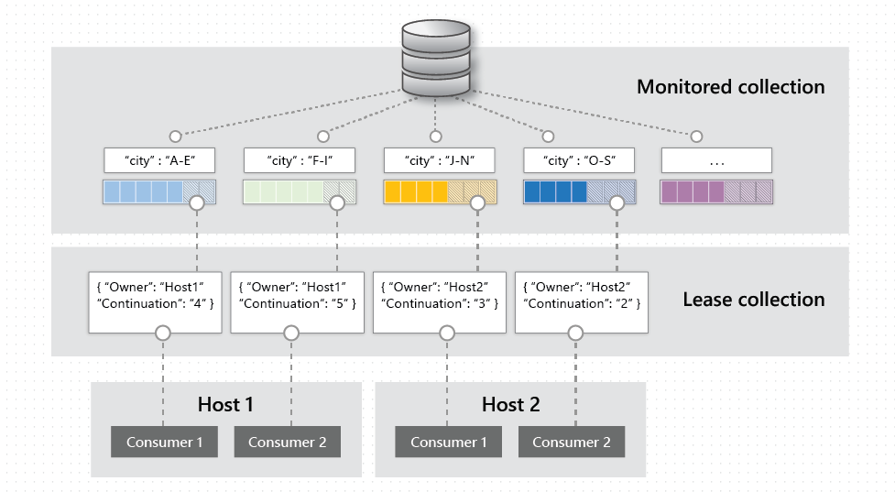
Change Feed to Process and Offload Data

Slide 29

Things to do vs. Things to avoid.

Slide 30
Select Proper Key

Slide 31

Our main recommendations ARE valid and very important to follow
Select proper partition key
Flatten the document structure
Optimize indexes
Avoid loading large documents
Avoid scanning through the collection
Avoid storing arrays / maps / nested documents within the document
Avoid storing historical data “forever”

Slide 32
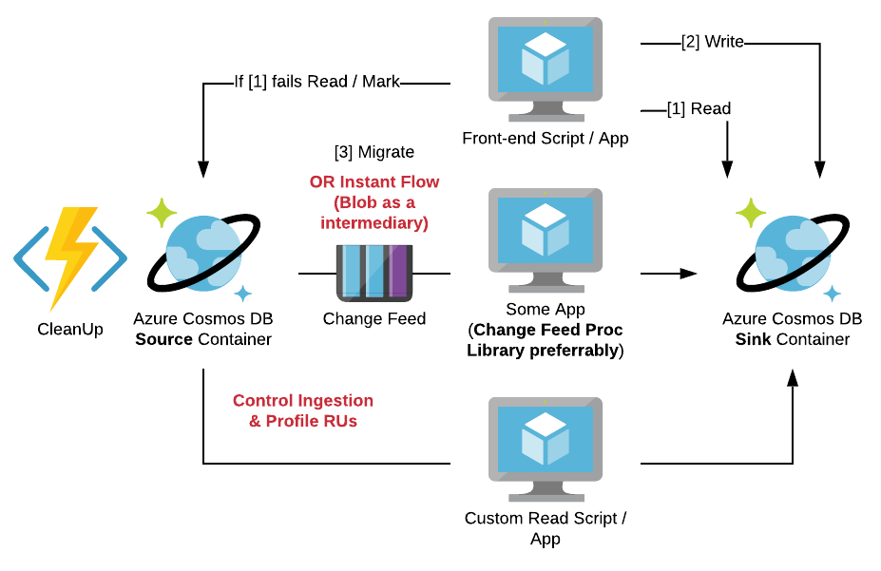
Prepare Data Migration Engine / Scripts
It is not that complex
Many savior capabilities can be based on this one:
Re-Partitioning (including mocking partition merge).
Global Index Creation.
Self-Controlled Backup / Restore.
Fast failover.
Expanding data footprint / duplicating data for whatever reason.
It will save customers in many ways and from many nasty surprises.

Slide 33
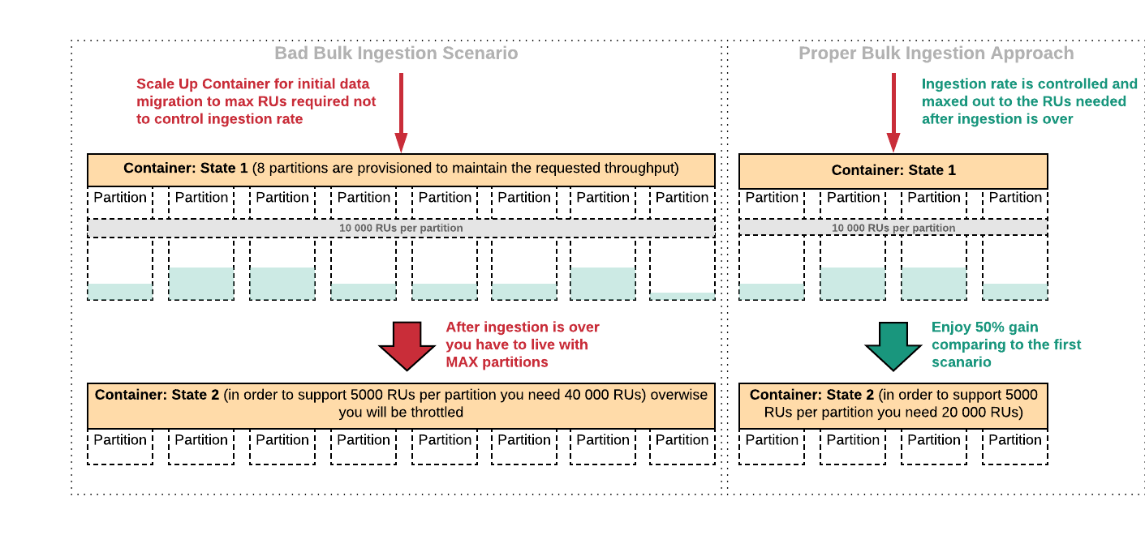
Control Ingestion During Bulk Inserts

Slide 34
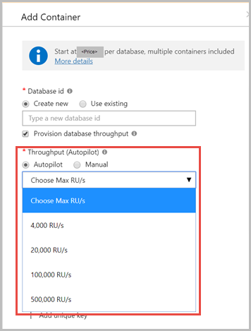
Use Autopilot to reduce RUs consumption
Enabling Autopilot allows you to guarantee that your workload will be stable over time and that RUs provisioned will not exceed significantly RUs needed for processing
Beware that it is based on the monitoring metrics so sometimes manual scaling can be used as well
Maximum throughput limit | Maximum storage limit
4000 RU/s | 50 GB
20,000 RU/s | 200 GB
100,000 RU/s | 1 TB
500,000 RU/s | 5 TB

Slide 35
Use Azure Data Explorer to work with arbitrary reads
Azure Data Explorer is a service which backs internal telemetry analysis in Microsoft
It is extremely fast and efficient way to query and analyze your time-series data
Azure Data Explorer is integrated with Event Hub and IoT Hub as well as can be integrated with CosmosDB Change Feed
ADX provides extremely good way to offload arbitrary queries from CosmosDB as well as analyze streaming data
let LightningStorms =
StormEvents
| where EventType == "Lightning";
let AvalancheStorms =
StormEvents
| where EventType == "Avalanche";
LightningStorms
| join (AvalancheStorms) on State
| distinct State
OREGON
UTAH
WYOMING
WASHINGTON
COLORADO
IDAHO
NEVADA

Slide 36
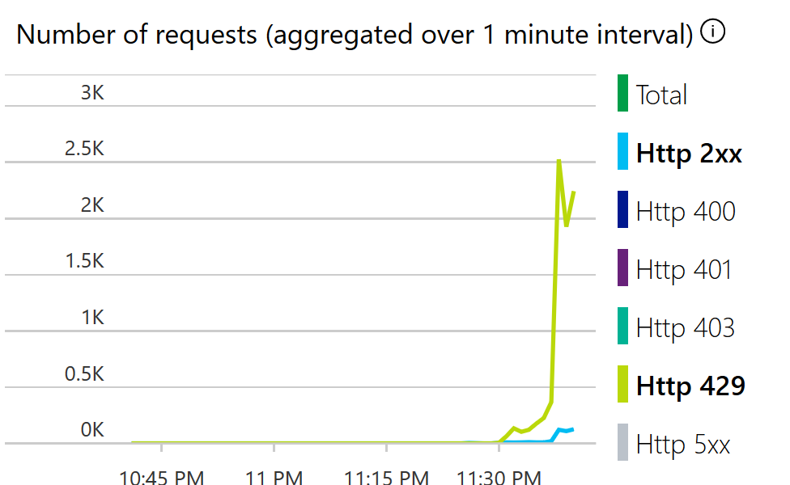
Try to Avoid Batching
Batching is very complex in profiling
Includes Indexes writes at scale
Includes Replication at scale
To easy to adjust RUs / partitions / jobs (especially with the 3rd party tools)
Enabled Change Feed will require some additional RU consumed in chunks
Batching consumes tons of RUs (refer to the previous point)
Deviations in batch task executions can easily hit the whole database and containers structure

Slide 37
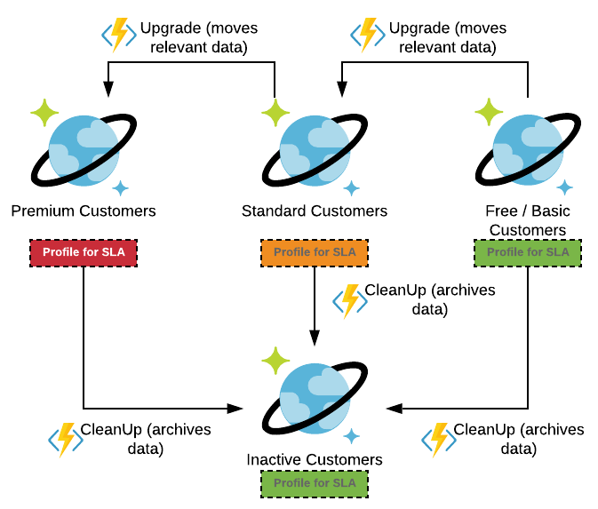
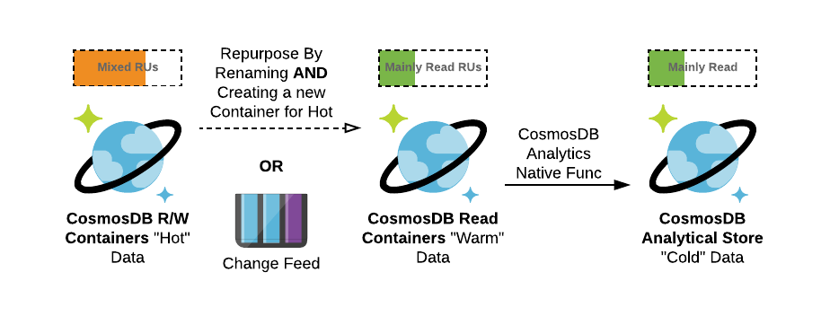
Profiling for purpose
Profiling for time (Hot, Warm, Cold)
Profiling for usage level / SLA (Special, Gold, Standard, Basic, Free)
Profiling for purpose (Writes, Aggregations, Lookups, Analytics)
Purpose
Time

Slide 38
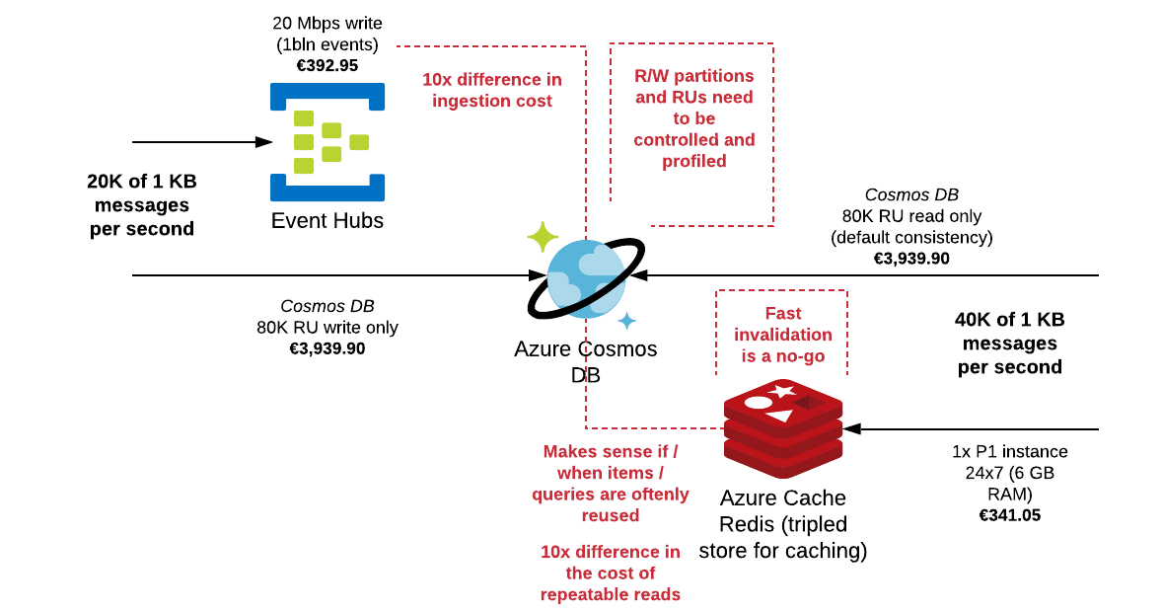
Caching & Streaming

Slide 39
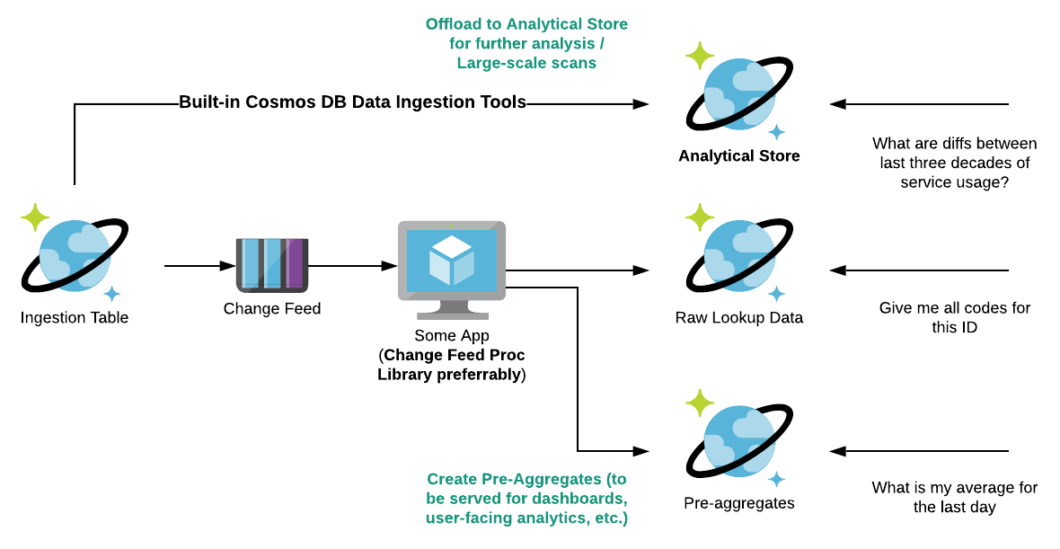
Offloading Data / Aggregating Data

Slide 40
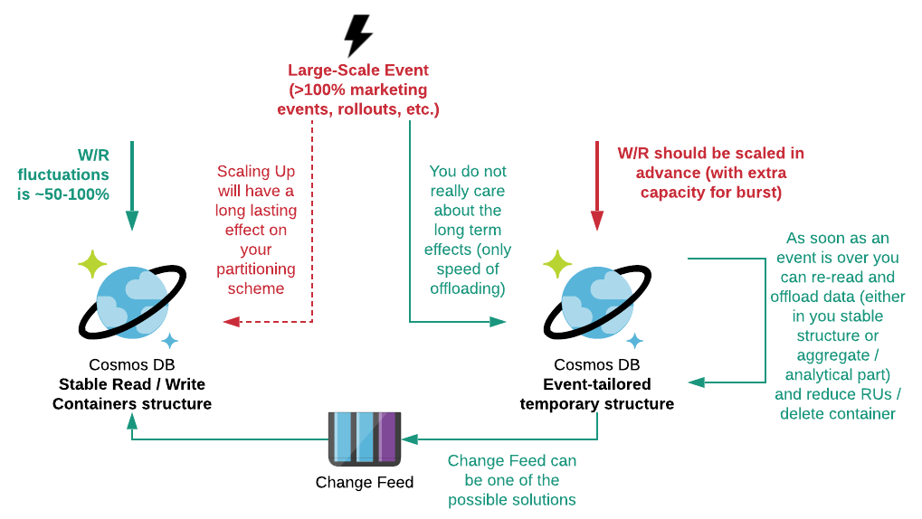
Dealing with large-scale events using temporary structures

Slide 41

Way to avoid troubles
Do not wait for fixes – THINK!
How the workload will behave
How it will scale
How it will failover
Design for worse
Do not expect – TEST!
PoC
MVP
Ops & Monitoring
Engage with
GBB

